Slide 1
INC300
Week 4
Digital Footprints

Slide 2
Today’s Agenda
Check-in
Lecture: Digital Footprints
Topics:
  What is a digital footprint?
  Why did we start leaving such big footprints?
  What is the economic bargain for Internet users?
  Are digital footprints a problem?
  Do different devices make different digital footprints?
  Managing Digital Footprints
  Who is tracking us? How do they do it?
  What dynamics are at work in the world of digital footprints?

Slide 3
Lecture 4: Digital Footprints
Learning Outcomes:
Understand what digital footprints are and why they exist
Understand the benefits and downfalls of digital footprints
Understand how different devices create different digital footprints
Acquire strategies and tools to manage digital footprints

Slide 4


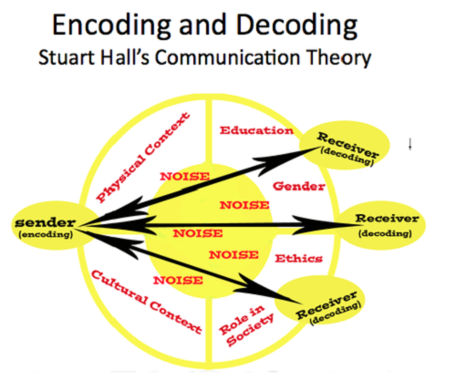
Week 3 Recap
Defined trolls and trolling, and explored the difference between trolling and harassment.
Looked at several case studies where deception was discovered in an online venue.
Explored theoretical frameworks that can be used to help understand these case studies.

Slide 5
Question:
Have you ever been surprised at how a website knew certain things about you?
  Do you see ads related to what you’re interested in?
  Are the ads that you see different than the ads your friends see?
  Do websites sometimes know your location even when you don’t tell them?

Slide 6
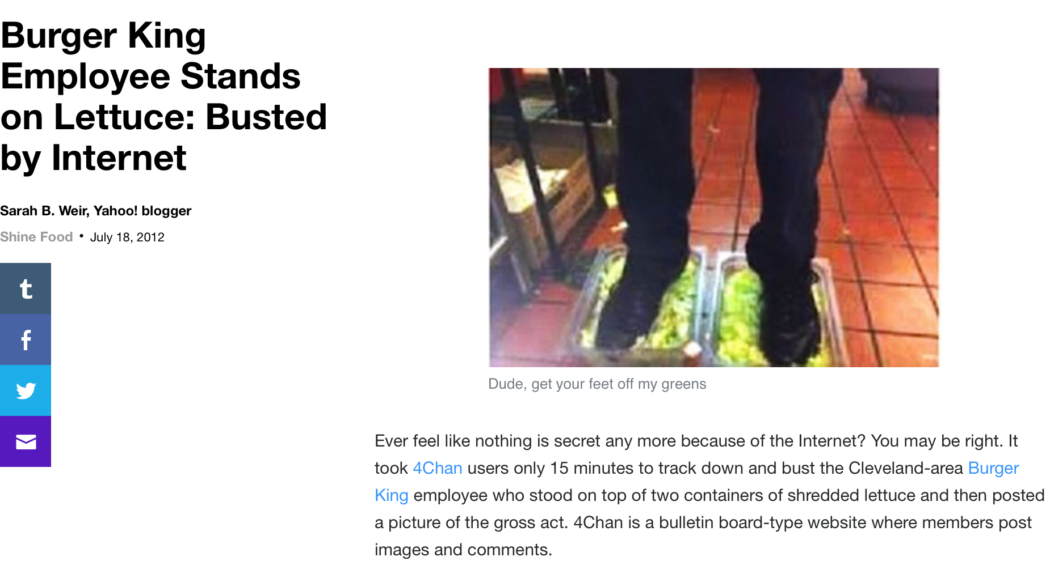
Case Study
A Burger King employee posts a picture of himself standing in the ingredients; other 4Chan users use the GPS metadata attached to the picture to figure out which franchise it is; employee gets fired.
Notes:
https://ca.style.yahoo.com/blogs/shine-food/burger-king-employee-stands-lettuce-busted-internet-163700384.html
What kind of digital footprints did this person leave?
Did they know they were leaving footprints?
How did other people find them?
What were the consequences?
How could the situation have been avoided?

Slide 7
What is a Digital Footprint?
Digital footprints are the records and traces we leave behind us as we use the Internet.
Digital footprints come with both benefits and costs.
  Benefits: your own digital footprint may contribute to your online reputation. Your digital footprint can mean you don't have to repeatedly log in or submit personal details to web sites.
  Costs: on the other hand, your digital footprints may allow others to follow your actions, such as which web sites you use, what things you search for, and who is in your social circle.

Slide 8
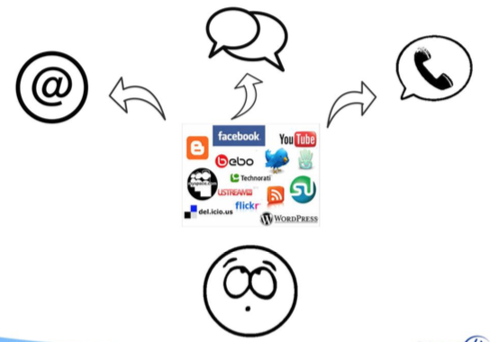
What is a Digital Footprint?
Our digital footprints are visible to organizations with whom we have no relationship, and over whom we often have no control. Many organizations also work behind the scenes to build profiles about us based on our digital footprints.
Most people are aware that when they share information about themselves on the Internet, such as with social networking services, and when they use on-line services, such as e-mail, instant messaging, or voice calling, they have given up some control over their privacy.

Slide 9

What is a Digital Footprint?
This loss of control is frequently the result of explicit acts, or active footprints: making a Skype call, sharing something on Facebook, uploading pictures to Tumblr, sending an email to a Hotmail user. We may expect some privacy, but we know we’ve given something up, and we’ve left a clear imprint at each of these individual services.
Notes:
“Active” footprints are those you leave when you make deliberate choices on the Internet. Posts you make to your own social media channels are a well-known form of active footprint. When you are logged into a project management or similar site, changes you make that are connected to your login name are also part of your active footprint.

Slide 10
Why Did We Start Leaving Such Big Footprints?
Your visits to different service providers generate data about you that piles up at each location; these are implicit acts or passive footprints. Service providers and other third parties exchange data about customer profiles and transaction statistics. This industry is a massive economic engine powering (and funding) much of the internet.
Over time, the technology to create profiles of Internet users has become increasingly sophisticated. Few users realize how extensive their digital footprints are, or how many third parties make up the complex ecosystem of data sharing and data monetization.
Digital footprints should be a significant privacy concern for Internet users, because they can be used to track user actions and are a basis for “profiling” by online service providers and others.
Notes:
“Passive” footprints are those you leave behind without intending to do so or, in some cases, even knowing you are doing so. For instance, websites that collect information about how many times you have visited in the recent past are adding to your digital footprint in a “passive” fashion. You don’t choose to hand them this data; they collect it when a device at your IP address connects with their websites. Because this is a hidden process, you may not realize it is happening at all.

Slide 11

Why Did We Start Leaving Such Big Footprints?
The explicit footprints we leave as we participate in Internet conversations can be obvious to us, if we pay attention to them.
For instance, if you Tweet that you have just arrived in Sydney and the sunset is spectacular, those are quite explicit disclosures about where you are and when (assuming you're telling the truth). But what about the implicit footprints?

Slide 12
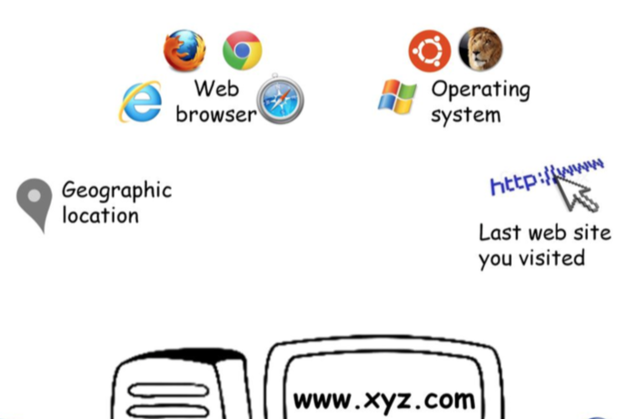
Why Did We Start Leaving Such Big Footprints?
Each time you visit a web site, you reveal some information about yourself to the owner of the web site: your IP address, which may include your geographic location, your web browser type and operating system, and, often, the last web site you visited. These bits of information seem relatively innocuous and even fairly anonymous. If these are footprints, they are fairly light ones. In fact, these footprints are “too” light for the purposes of some online service providers.

Slide 13
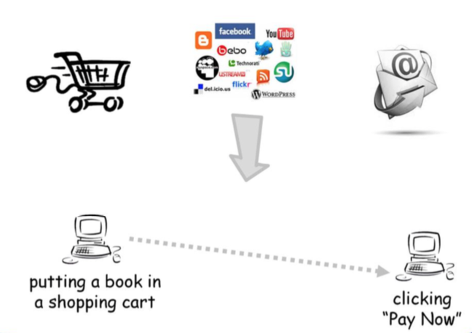
Why Did We Start Leaving Such Big Footprints?
Internet services, such as online commerce, social networking, and e-mail, require that a web site be able to link up multiple interactions, such as putting a book in a shopping cart, and later clicking “Pay Now”.
They need to know when the person doing something now is the same person who did something previously – and often this is in the user's direct interest, too.

Slide 14
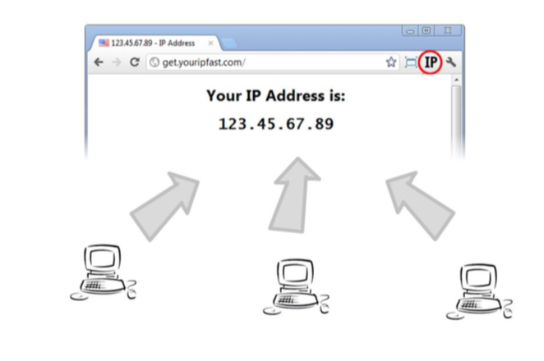
Why Did We Start Leaving Such Big Footprints?
IP addresses won’t do the trick, because several people might be using the same IP address at the same time: something more is required.
One solution to this problem is the cookie (not of the edible variety….)

Slide 15

Why Did We Start Leaving Such Big Footprints?
A cookie is one way of tying multiple actions by a single user into one connected stream.
A cookie is an arbitrary string of letters and digits - something without any inherent meaning - that a web site sends to your web browser.
Digital footprints in the form of cookies are used to make the Internet more usable, and can also help make individual transactions more secure.
Transaction security decisions rely on a combination of factors, including cookies. Web developers have settled on cookies as one of the most convenient ways to add persistence and security to your web experience, which is why they are everywhere.
Notes:
Video embedded in picture of cookie: https://www.youtube.com/watch?v=IPQhME1UYQU

Slide 16
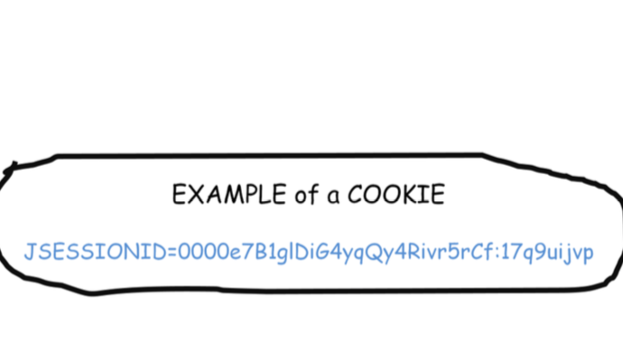
Why Did We Start Leaving Such Big Footprints?
Here’s a typical cookie. As you can see, it looks pretty meaningless. But, like any cookie, if you know how to interpret it, it contains useful and valuable data.

Slide 17
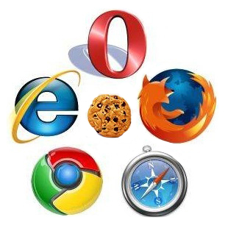
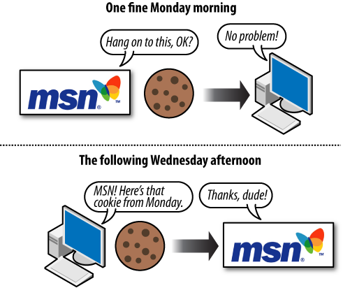
Why Did We Start Leaving Such Big Footprints?
Web sites generally set a cookie in your browser at the instant when you first visit the site. The web site can store profile and preference information in the cookie.
Your web browser stores the cookie when requested, and then every time you revisit the web site, the web browser sends the cookie back to the web server. The browser stores the cookie behind the scenes, and then sends the cookie back to the web site every time you click.

Slide 18
Why Did We Start Leaving Such Big Footprints?
One result is that the web site can stitch together your actions to improve your user experience—even if they’re separated by days, weeks, or months. Most users don’t think about it, but by default, their web browsers contain thousands of cookies, placed there by each web site they visit. However, this also means you’re leaving bigger and bigger footprints. Cookies don’t just link up transactions; they enable web sites to keep track of you every time you visit.

Slide 19
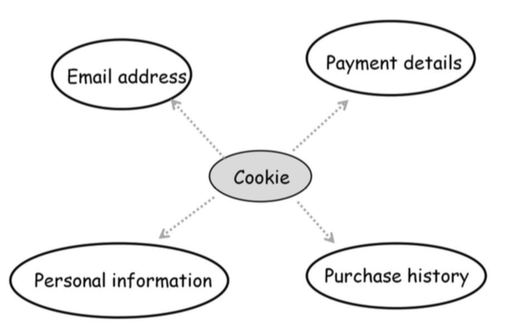
Why Did We Start Leaving Such Big Footprints?
If a service provider holds account information for you, such as your email address, payment details, purchase history or other personal information, the cookie can be used to link this information and everything else you subsequently do on that service provider's site.

Slide 20
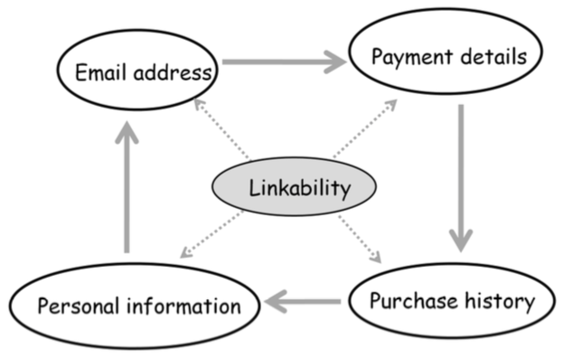
Why Did We Start Leaving Such Big Footprints?
The concept of linkability is a key one in any analysis of online privacy, because linkability does more than almost anything else to erode users' ability to keep personal data within a single context, and thus to manage their own privacy.
Each individual footprint is small, but when linked they can form a surprisingly complete profile about us. When web sites decide to share this information with each other, it becomes possible to build a profile for you, using raw data such as the web sites you’ve visited, the products you’ve bought or searched for, your address, and any other bit of information you’ve given to any cooperating web site: age, sex, health, marital status, employment, financial information ... the list is as long as everything you’ve ever shared on the Internet.
In fact, it is longer – because based on the raw data, profiling companies make inferences about your habits, preferences, values, aspirations, and even your intentions and future behaviour.

Slide 21
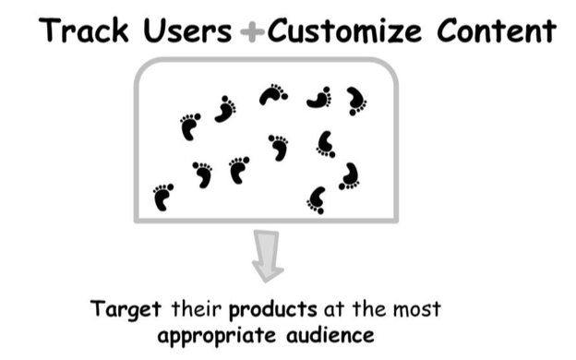
What is the Economic Bargain for Internet Users?
Digital footprints would exist even if there was no commercial need for them, but the commercial side of the Internet has capitalized on the opportunity they represent.
The heavy use of digital footprints to track users and customize content is an outgrowth of the basic economic bargain of the Internet. Because most of the infrastructure of the Internet is funded by marketing in some form, publishers and marketers exploit digital footprints to target their products at the most appropriate audience.
Advertisers and marketers have grown dependent on the power digital footprints have given them to observe, link and mine data about Internet users.

Slide 22

What is the Economic Bargain for Internet Users?
Online services are not truly free of charge, and never have been.
A lot of the content and services seem to be free, in the sense that we don’t directly pay for them.
There are exceptions - some newspapers and magazines, streaming services (ex. Netflix, Spotify), and chargeable information services such as industry analyst reports.
For the most part, there is no apparent cost to view data on a web site, read someone’s blog, watch a video, post a picture, or join a social network.
But the word “apparent” is significant: even if we’re not paying directly, we are paying indirectly. Someone has to fund the servers, the data centers, and the networks that underpin online service provision.

Slide 23
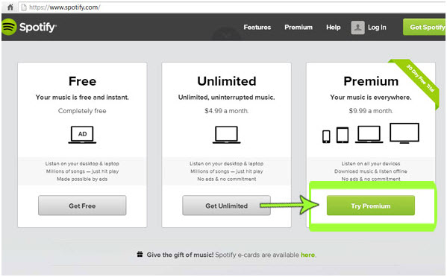
What is the Economic Bargain for Internet Users?
If you don't pay a subscription fee for a service or application, that service is funded by monetizing information about you, your social circle, and your collective interests and preferences.
However, even if you pay a subscription for a service, or a premium for an “ad-free” version, it does not guarantee that your personal data is not collected and monetized.

Slide 24
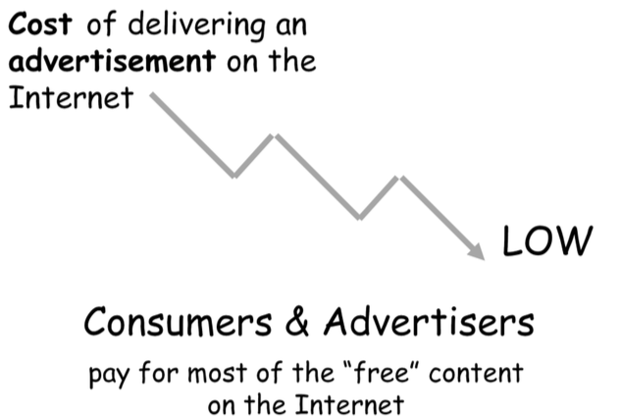
What is the Economic Bargain for Internet Users?
For almost every Internet site, every time you look at a web page, someone has an interest in showing you an advertisement.
The cost of delivering an advertisement on the Internet is very low compared to other mechanisms, such as billboards, newspapers and magazines. This means that consumers and the advertisers who want to reach them pay for most of the “free” content on the Internet— and leave a healthy profit margin — for someone.
This trade of your eyeballs for their servers, networks, and content is the essential economic bargain underlying most of the Internet.

Slide 25
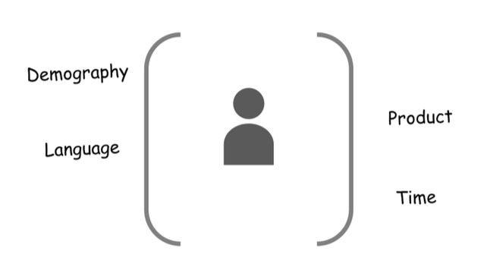
What is the Economic Bargain for Internet Users?
From the perspective of the marketers, the Internet offers both opportunities and challenges.
  The opportunity is of cheap, direct access to receptive consumers.
  The challenge is that the Internet is so information-rich that it can be hard sorting the receptive consumers from the rest.
Maximizing return from the Internet requires a holistic view of the consumer.
Given the diverse nature of the global market, advertisers and publishers who place their ads need to find out as much as they can about their audience. This helps them identify the right demography, the right language, the right product, the right time, and all the other factors that can help them target the consumers effectively.

Slide 26
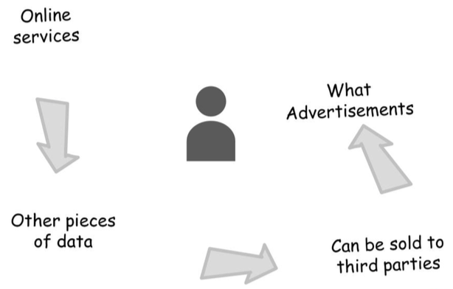
What is the Economic Bargain for Internet Users?
Online services collect data about what you do:
  some of that data is used directly to improve your experience (for instance, language settings, or single sign-on).
  Other pieces of data build up into profiles of you and the other consumers who resemble you in some way.
That information, or inferences drawn from it, can be sold to third parties and used to decide what advertisements are most likely to influence you, and when. There may be no apparent connection between your visit to one web site and the advertisements you subsequently see, there or somewhere else.

Slide 27
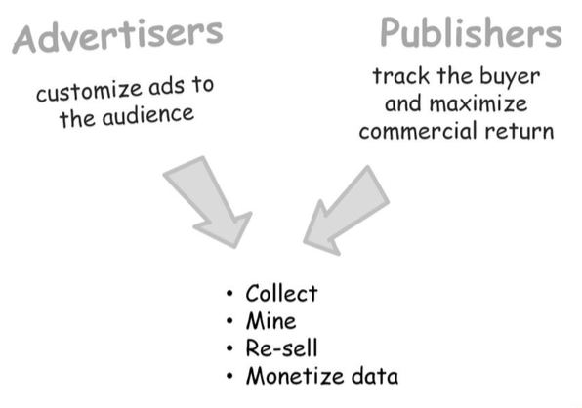
What is the Economic Bargain for Internet Users?
These are powerful forces: advertisers' desire to customize ads to the audience; publishers' wish to charge the highest possible sum for showing someone an advertisement, and the incentive to track the buyer and maximize commercial return. They create an overwhelming incentive to collect, mine, re-sell and monetize data about consumers, and power a commercial engine over which the individual consumer has little or no influence.

Slide 28
Are Digital Footprints a Problem?
One of the side effects of digital footprints is a loss of privacy and anonymity online.
As we participate in various Internet activities, we leave behind evidence of what we’ve done, where we’ve been, what we’ve been thinking, who our friends and families are, and more. These footprints build up over time, and can become enormous.
The implicit footprints we leave behind also can be used to track us, and to link information we have shared, in one context, into a larger and more complete profile that extends across the contextual boundaries of what we do online. The privacy implications of linkability are profound, because online linkability challenges some of our fundamental assumptions about how we preserve our privacy in the offline world.

Slide 29
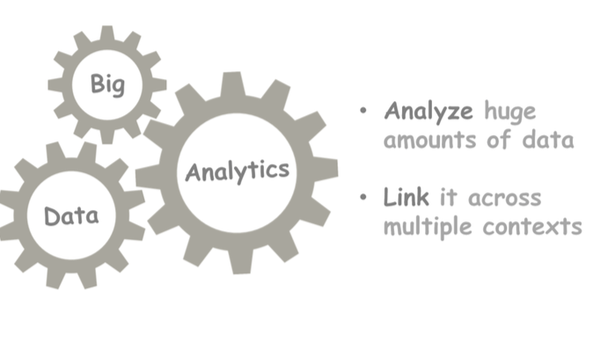
Are Digital Footprints a Problem?
In an era of “big data” analytics, organizations—not just governments— are able to analyze huge amounts of data from our footprints and link it across multiple contexts.
Notes:
Big data is a term that describes the large volume of data – both structured and unstructured – that inundates a business on a day-to-day basis. But it’s not the amount of data that’s important. It’s what organizations do with the data that matters. Big data can be analyzed for insights that lead to better decisions and strategic business moves.

Slide 30
Are Digital Footprints a Problem?
When an advertisement pops up on a web page for an object researched two days ago on a different site, it's a sign that someone has been sharing our activities with the advertiser. If we expected those two contexts to be separate, we are likely to feel that our privacy has been violated.

Slide 31
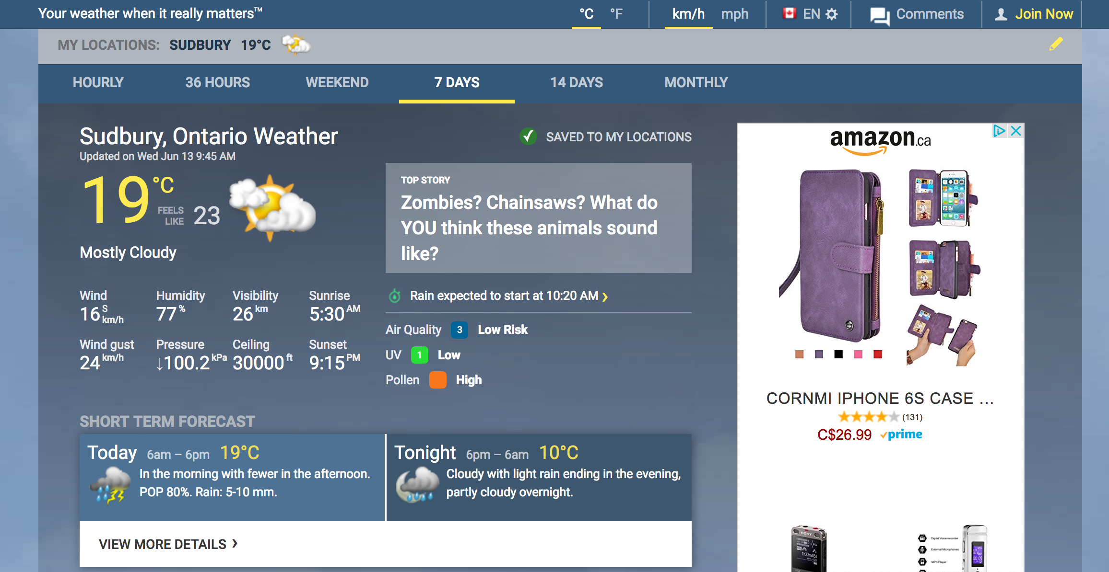

Slide 32
Are Digital Footprints a Problem?
The Universal Declaration of Human Rights offers everyone a “right to privacy,” but there is no universal agreement how privacy works on the Internet.
Privacy, like other human rights, is a social convention – and a subtle and complex one, at that.
The technology of online service delivery is still an immature and unwieldy way to express those subtleties in our digital lives.
Although the Internet and its associated commercial services happen to have developed in a particular way there is scope – and a pressing need – for improvement.

Slide 33
Are Digital Footprints a Problem?
In addition to privacy, there are other, related areas in which individuals' interests are potentially put at risk because of their digital footprints. One such area is anonymity; individuals may have a legitimate interest in going online without being obliged to identify themselves.
It takes very little information to tear the veil of anonymity. The linkages between digital footprints, IP addresses, phone numbers, e-commerce, and
online activities all make it possible to ascribe “anonymous” actions to a real-world identity.
These links can often be made by parties whose activities run counter to the legitimate interests of the individual trying to remain anonymous.

Slide 34

Are Digital Footprints a Problem?
It's not just about advertising. When footprints are shared between online merchants for advertising purposes, the violation of privacy and reduction in anonymity might generally be little more than an annoyance.
However, the same data can be used for more malicious purposes - whether financial, criminal or official. Once data can be linked and matched to a specific identity, then there is a real risk that online activities can have damaging consequences for the individual in question.

Slide 35
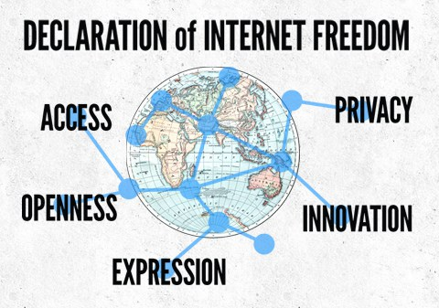
Are Digital Footprints a Problem?
As well as its potential impact on specific individuals, the loss of privacy and anonymity has a broader effect in the Internet at large. It reduces public trust in the Internet, inhibits freedom of expression and freedom of action in the online domain, and diminishes the Internet as an economic and social asset for everyone.

Slide 36

Do Different Devices Make Different Digital Footprints?

Slide 37
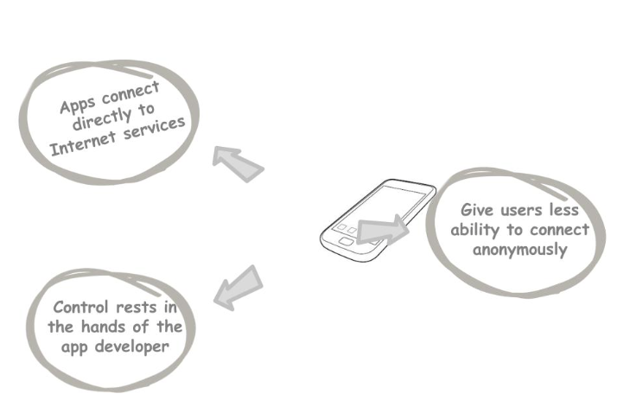
Do Different Devices Make Different Digital Footprints?
Smartphones and tablets tend to leave a very different footprint from laptops and desktop computers.
Modern smartphones work in ways that create a more intrusive footprint.
Apps connect directly to Internet services using specific interfaces. Control over which information is sent to other services/devices rests in the hands of the app developer, and is exposed to the end user only to the extent the developer permits. Mobile devices, in particular, also give users less ability to connect anonymously.

Slide 38
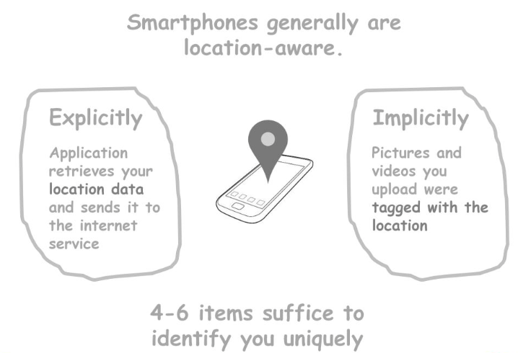
Do Different Devices Make Different Digital Footprints?
Smartphones generally are location-aware. This makes it’s possible for services to tag your activities to your location. Location services are often enabled by default, or included in a bundle of permissions the user is asked to grant when an app is installed.
The location data can be shared explicitly, if the application retrieves your location data and sends it to the Internet service, or implicitly – for instance if the pictures and videos you upload were tagged with the location, date and time they were taken.
It is reckoned that 4-6 items of location data are enough to identify any given user uniquely.
Notes:
http://app.teachingprivacy.org link in the photo
This app shows how people could use someone’s social-media posts to find them in the physical world. The user types in a Twitter or Instagram ID, and the app uses GPS data attached to their posts to create a timeline and heatmap of where they’ve been posting from recently.

Slide 39
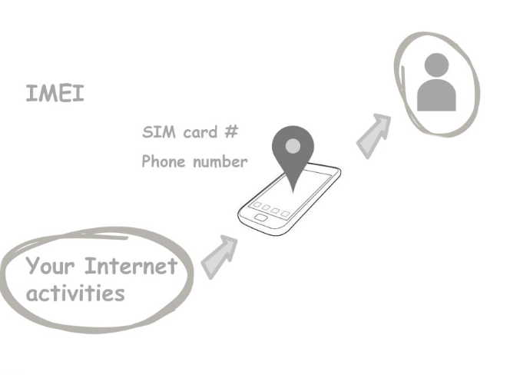
Do Different Devices Make Different Digital Footprints?
Smartphones are designed as very personal devices, and contain multiple unique identifiers, including the IMEI (International Mobile Station Equipment Identity), the SIM card serial number, the phone number itself, of course, and now usually a MAC address, Bluetooth identifier, and so on. Your mobile phone carrier can link your all your subscriber details (name, address, payment details etc) with all of your Internet activities, bridging the physical and virtual worlds.
Because many countries now require some type of identification to register all mobile phone subscribers, it becomes simple for third parties, such as law enforcement agencies, to link Internet activity to a particular smartphone and thus to an individual user.

Slide 40
Do Different Devices Make Different Digital Footprints?
Mobile devices are not unique in identifying the subscriber. The same principle of some type of authentication and registration applies to payment, banking, and Internet services, making linkage between on-line and real-world activities easy for anyone who has access to the registration data.
What may then distinguish the two cases is the extent to which a given country's laws control service providers' behaviour. This may be in the form of privacy regulations that apply to a specific industry (e.g. financial services), or to the use of personally identifiable data regardless of which industry is involved.

Slide 41
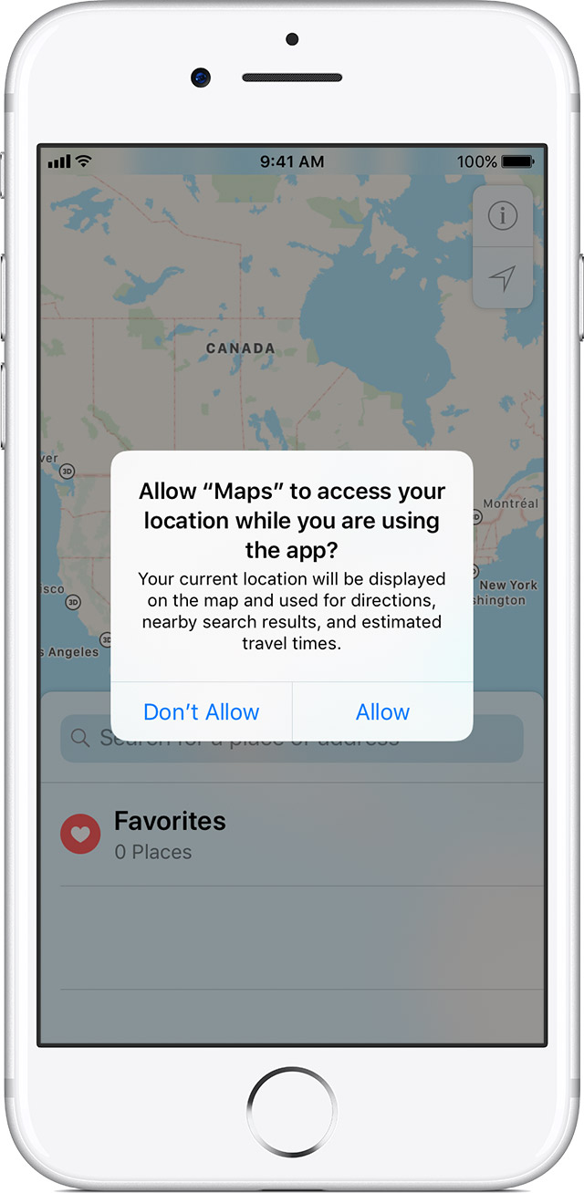
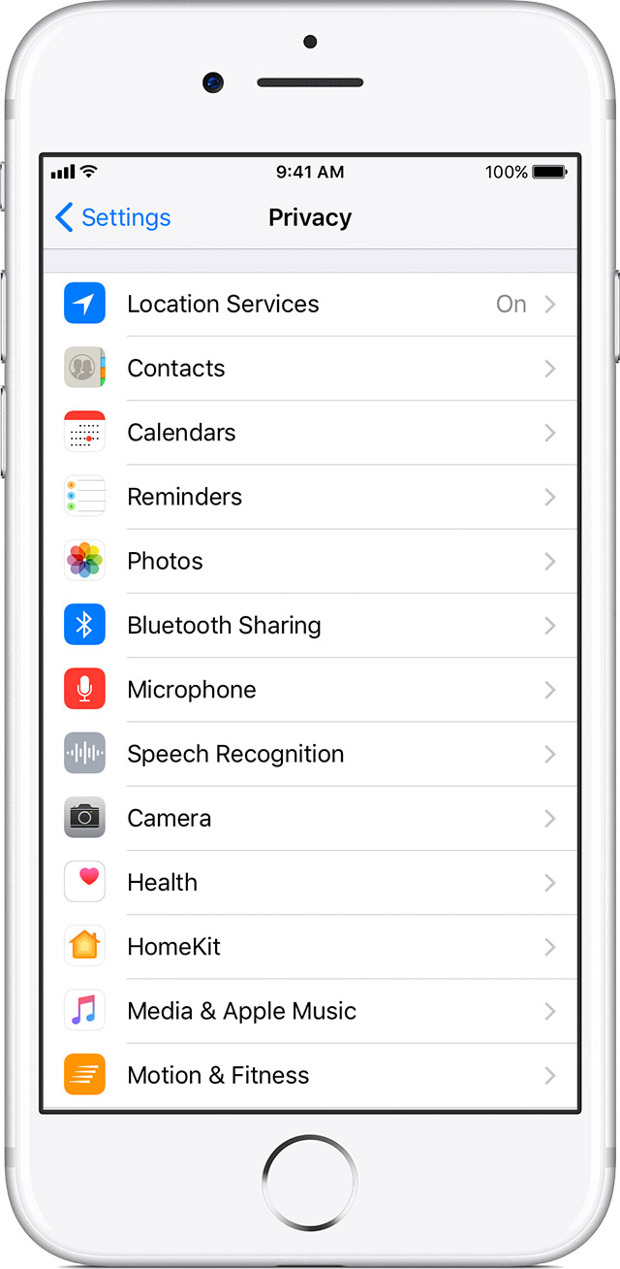
Do Different Devices Make Different Digital Footprints?
Smartphone vendors, generally implement controls over whether location data are shared, and to block the use of device-specific identifiers by applications. This is not something over which the user has control.
Some controls over sensitive information, however, are based on settings at the device level, and others at the application level. These capabilities vary significantly by smartphone platform; so does the level to which they are documented, and the ease with which the average user can discover and manage them.

Slide 42
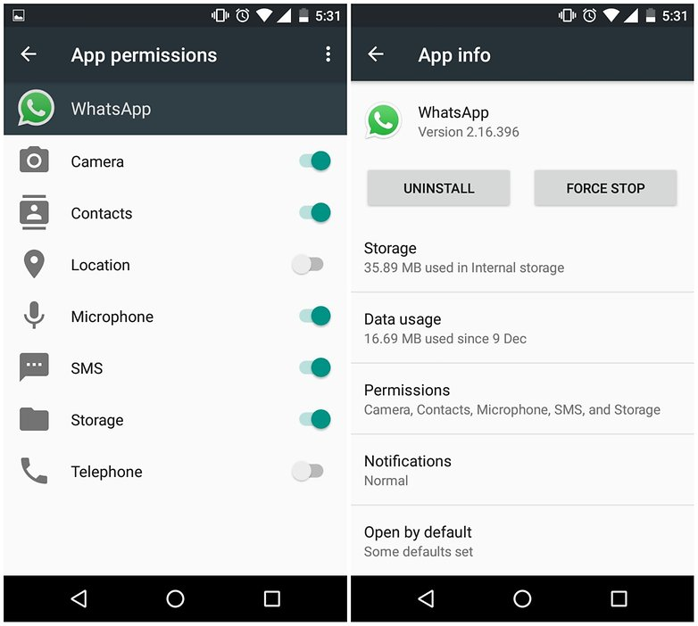
Do Different Devices Make Different Digital Footprints?
But once a user starts taking tagged pictures, or gives permission to a newly installed application to see location information, the permission granted to the application is rarely revisited.

Slide 43
Do Different Devices Make Different Digital Footprints?
Even a diligent consumer who regularly checks their privacy preferences is sharing more information than they have permitted.
For example, simply turning on a mobile phone allows the carrier to locate the phone to a certain degree of accuracy. And if someone else “tags” you in a photograph they’ve uploaded to a social network, your location at a particular date and time have just been shared on the Internet by your friends—even if your own smartphone is switched off and lying on the kitchen table at home.

Slide 44
Do Different Devices Make Different Digital Footprints?
In some cases, the device vendor may have access to sensitive and private information on the smartphone.
An individual's privacy can be affected by the actions of many other entities.
Entities that may affect an individual’s privacy while using a mobile device include:
  Device/smartphone vendor,
  App developer,
  Network operator,
  Operating system developer,
  Internet Service Provider (ISP),
  Online service provider (e.g. retailer, social network),
  Friend/acquaintance...
  or their app, and/or Other device.

Slide 45
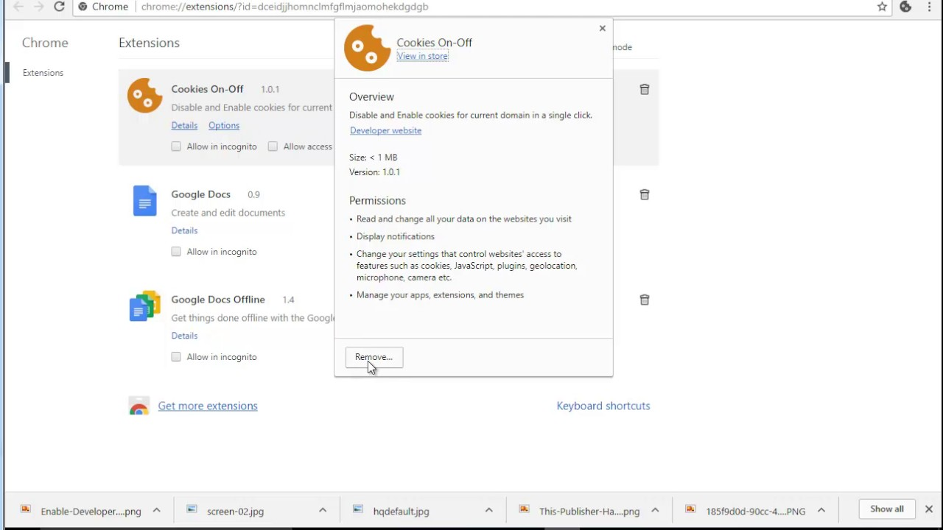
Do Different Devices Make Different Digital Footprints?
Users of desktop computers and laptops primarily leave footprints via their web browser.
The standard web browser is very different from the applications that smartphones and tablets use.
The comparatively mature controls offered by browsers themselves, or by supplementary plug-ins, make it easier for the end user to control what is shared, and to clear out identifying information such as cookies that might otherwise reduce personal privacy
Thus, as of now, desktop computers do have a privacy edge over smartphones. But they won’t be able to keep it for long.
As user expectations are increasingly driven by the smartphone/tablet experience, the pressure is on for operating systems such as Windows 8 to act more like a smartphone than a 'traditional' desktop computer - with the same potential loss of user control and privacy.

Slide 46
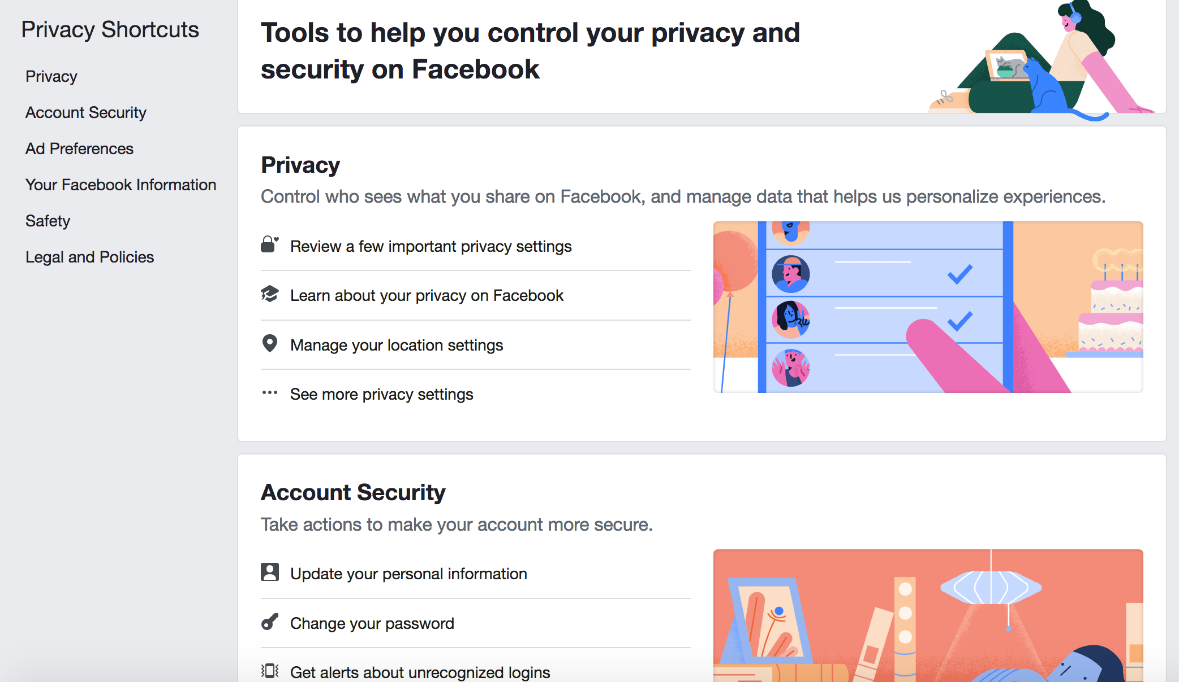
Do Different Devices Make Different Digital Footprints?
Internet users concerned about the digital footprints left by their smartphones need to take an active role in managing their privacy settings.
The task of carefully monitoring and controlling privacy poses a significant overhead and may be more complex than many smartphone users expect. The challenge for all of us, as consumers and users, is to recognize the value of our personal information and our privacy: only by adjusting our values and, as a result, our behaviour, can we hope to make better, sustainable decisions about privacy.

Slide 47

Managing Digital Footprints
Managing your digital footprint takes thought, time, and effort
We have to struggle against our own inertia in the face of convenient but privacy-eroding defaults, and against the concerted, persistent efforts of organizations who have a financial interest in persuading us to sacrifice our privacy in the interest of their profit.

Slide 48
Managing Digital Footprints
There are four levels at which you can choose to manage and control your digital footprints:
  First → Improve your understanding of the basic issues
  Second → Develop your “basic hygiene” habits
  Third → Become a sophisticated user of your online tools and services
  Fourth → Find and use specific privacy-enhancing tools

Slide 49
Managing Digital Footprints
1) Improve your understanding of the basic issues.
Think about the implications of everything shared on the Internet being a privacy risk to some degree

Slide 50
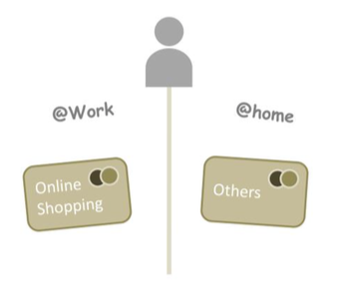
Managing Digital Footprints
2) Develop your 'basic hygiene” habits.
Privacy is a contextual thing. If you use different “personas” for different aspects of your online life – whether that's one email address for work and another for home, or a one credit card for online shopping and another for everything else – it will help keep different parts of your digital footprint separate.
Be mindful about what you share via social sites and elsewhere, because that data is probably more public and persistent than you might anticipate.

Slide 51
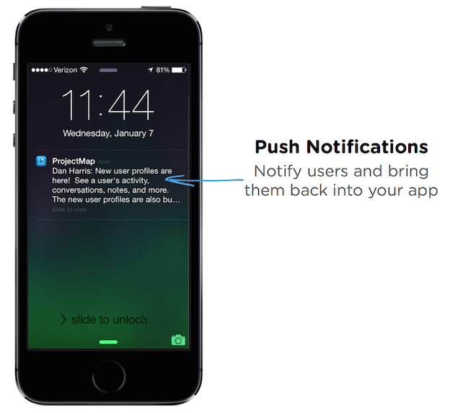
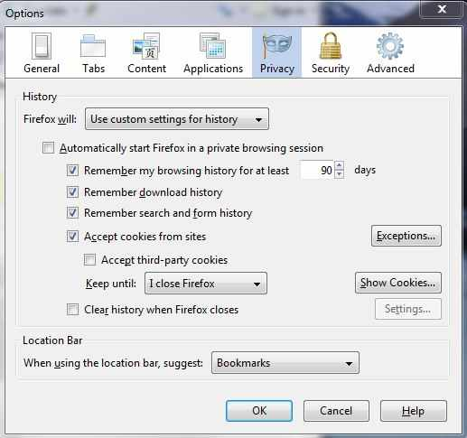
Managing Digital Footprints
3) Become a sophisticated user of your online tools and services.
Very often, the default settings for browsers, devices and apps are set to disclose, rather than secure, your personal data. It's worth taking the time to investigate those settings and make sure you're comfortable with them, just like it's worth checking whether you latched the windows before you left the house.
When an application asks for “permission to send you push notifications and use your location data”, take a moment to reflect on whether that's really what you want.
Your camera and smartphone usually record the time and location in each photo you take, and when you share those photos, you may be publishing that data unless you specifically block it.

Slide 52
Managing Digital Footprints
4) Find and use specific privacy-enhancing tools.
There are many privacy-enhancing tools out there, especially for browsers. You can use them not just to protect specific areas of your digital footprint, but also to maintain your awareness and understanding of what service providers are looking at.
The tools displayed here is just a starting point; there are many more tools available.
Ghostery → a browser extension that blocks advertisers and web publishers from tracking your online behavior
Disconnect→ a browser extention that protects you from tracking, malware, and malvertising, and offers secure Wi-Fi and bandwidth optimization features that just aren’t available in other tools. It blocks third party tracking cookies and gives you control over all site scripts and elements from a simple-to-use toolbar menu.
DoNotTrackMe → a browser extension for blocking trackers

Slide 53
Managing Digital Footprints
With that four-layered approach in mind, here are some tips you can put into practice.
  Step 1: Manage cookies
  Step 2: Check privacy settings
  Step 3: Understand the realities of data sharing

Slide 54
Who Is Tracking Us? How Do They Do It?
Three main kinds of entities who work together to track users and create composite profiles are the Advertisers, Publishers, and Aggregators (also known as Data Brokers).

Slide 55
Who Is Tracking Us? How Do They Do It?
The advertisers are companies that have products or services to sell and therefore they market them.
  They can work directly with a publisher. For instance, a car manufacturer may ask an online campaigner to market its new car online.
The publishers are companies that publish advertisements online. Pairs advertisements with web page content, games etc. Could be any online magazine, search engines, blog publishing platforms or website.
Data aggregators collect anonymous data from their partners and use it to help create target ads

Slide 56
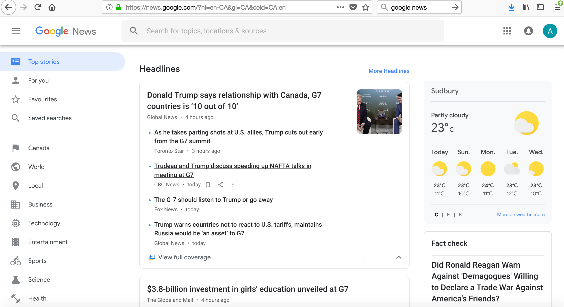
Who Is Tracking Us? How Do They Do It?
How cookies are used to track you.
Ex. Google’s News is a news aggregation site, providing pointers to the top news stories from thousands of news sources. If you have no relationship with Google and you simply click open the web page, you’ll see the top stories, customized for your current location.
So how does Google know your location and customize the news? Well, Google tracks your location, (such as “New York” in this case) based on your IP address. The news stories on your browser are optimized according to your location.

Slide 57
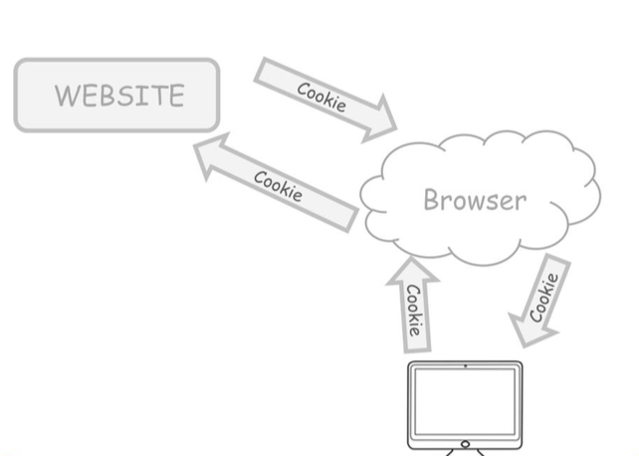
Who Is Tracking Us? How Do They Do It?
When you browse a website, the site places a tracking cookie in your web browser. The browser will store that cookie on your device. The browser’s job is to send that cookie back to the web site each and every time you return to it or ask for another page.

Slide 58
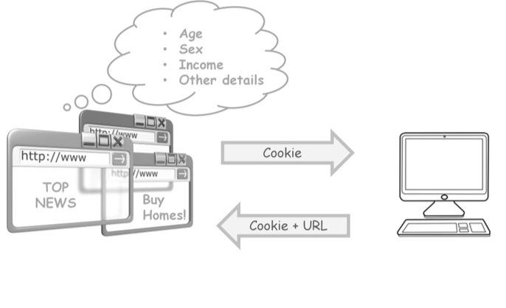
Who Is Tracking Us? How Do They Do It?
Each of the web sites that you browse operates independently and send tracking cookies to your browser. The browser will only send back the URL of the content that you looked for and the cookie to the web site that sent them. If any of those web pages have advertisements from third parties on them, the third parties will also send their own tracking cookies. The websites don’t really have any information about who you are or your profile since you did not authenticate to any of these websites, but they can still guess your age, sex, income and other details from your reading and browsing habits.

Slide 59
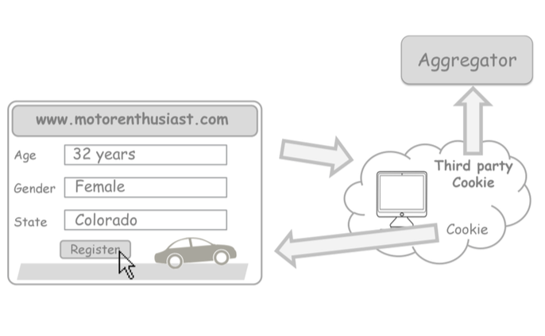
Who Is Tracking Us? How Do They Do It?
Let’s take a look at another example. This time, we'll assume that you have started by logging in to an account you created on one of your favourite sites.
Suppose, you’ve created an account on a motor-sports enthusiast website, and identified yourself as 32 years old, female living in Colorado. The motor-sports web site places a cookie in your web browser, as before, but this time it also leaves a “third party cookie” with data for the aggregator. This is a cookie left by one website, but containing the URL (the “return address”) of another – in this case, the aggregator. Your browser sends back the cookie to both the website that you just browsed as well as to the data aggregator.

Slide 60
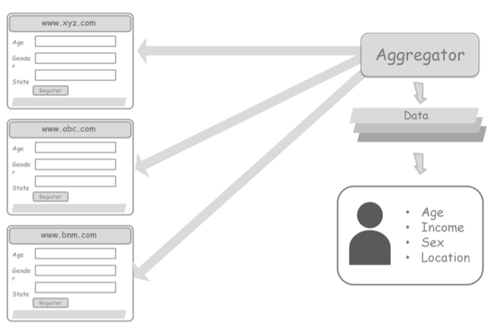
Who Is Tracking Us? How Do They Do It?
The data aggregator gets data from multiple websites. The aggregator puts all this together, filters them and profiles the user with dozens of different criteria: age, income, shopping habits, sex, location, interests, you name it.

Slide 61
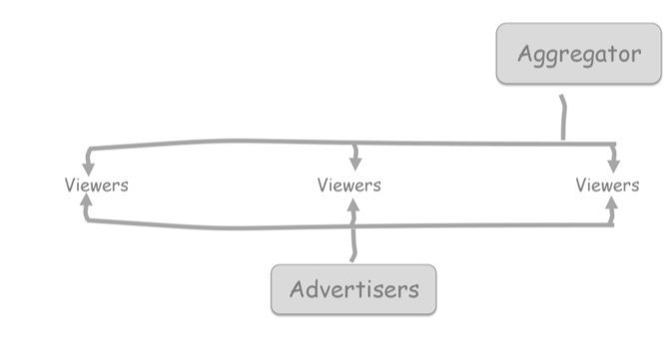
Who Is Tracking Us? How Do They Do It?
Aggregators work with publishers to sort viewers into different categories, and then offer advertisers the prospect of access to those “eyeballs”.
So, when the maker of a new baby car seat for sports cars wants to reach customers, you being a member of the motor-sports enthusiast website get to see their advertisement the next time you go to a web site allied with that aggregator.

Slide 62
Who Is Tracking Us? How Do They Do It?
Data aggregators compile information from databases or partner websites on individuals and sell that to advertisers to target ads.
Aggregators have a lot of data on Internet users. In early 2013, BlueKai had information on 85 million unique users, OutBrain offers up 364 million, Rio claims nearly 500 million.
There is big $ to be made – one of the largest aggregators, Acxiom, reported over $800 million in revenue in 2015!
The assumption that third-party tracking cookies are anonymous is widely disputed. Although most aggregators take pains to not store information that directly identifies a person, researchers have shown that this is not much protection. It only takes a few data points, especially when location is included, to track a set of web events back to a real person—which offers the possibility of following that real person both back and forward in time.

Slide 63
Who Is Tracking Us? How Do They Do It?
For the most part, digital footprints are used in a commercial context by companies who want to market products and services to us. In that context, the visible result is generally an innocuous, but slightly creepy, impression that someone is following you around and trying to sell you stuff tailored to your apparent interests. But digital footprints can also result in a loss of anonymity, through the sharing of information by third parties who have little regard for the consumer's privacy.

Slide 64
What Dynamics Are At Work in the World of Digital Footprints
The online world reaches into our lives so pervasively that it is often hard to untangle the dynamics that govern its behaviour.
However, three themes stand out from the rest: the cultural dynamic, the economic dynamic, and the dynamic of convenience.

Slide 65
What Dynamics Are At Work in the World of Digital Footprints
Cultural Dynamic:
Online services, while accessible worldwide, must all originate somewhere, and that often infuses them with a particular cultural perspective. Each country brings to the Internet its own cultural norms, legislative and regulatory models, and economic frameworks.
Digital footprints produce different reactions across the diverse constituencies that make up the Internet.
What is acceptable and common to one group is sometimes unacceptable and unusual to another. This is part of the nature of the Internet. The answer may seem simple to many.
If you don’t like the privacy model of a particular Internet service... choose an alternative.
However, this advice only works if two things are true: Internet users are aware of the privacy and data protection implications for every service they use; and a true choice of services is available.
However, we know from our experience that neither of these statements is always true. Not every Internet user knows how services are sharing their information, not every service has a substitute, and sometimes all the alternatives suffer from the same drawback.

Slide 66
What Dynamics Are At Work in the World of Digital Footprints
Economic dynamic:
The economic dynamic gives a service provider a strong incentive to collect data, and to keep users under-informed about that aspect of the service.
Thus, even Internet users who are very active in controlling the digital footprints they leave, have no option but to rely on imperfect knowledge.
For instance, it is in the interests of a social network service to encourage users to ignore the fact that everything they do within their social circle is being inspected and monetized by a third party.
In some areas, even if competing services are available, other factors might make the competitive service unattractive – for example, a social network will have little appeal if none of your friends is using it.

Slide 67
What Dynamics Are At Work in the World of Digital Footprints
Dynamic of convenience:
Most of us would rather use something which is convenient but privacy-eroding, than use a product that makes life less convenient for us. Like many kinds of human behaviour (smoking, eating fatty food, poor posture), if we cannot see an immediate harm from our actions, we tend to assume they aren't harming us. The combination of convenience and lack of apparent harm lulls us into privacy-eroding habits.
In short, our chances of changing our behaviour depend on the value we place on our privacy, relative to the “convenient” alternatives.
The first step is to acknowledge the different cultural models at work, and understand that Internet users come to the table with different backgrounds, expectations and values. Open discussion between significant stakeholders can help to educate both end-users and service providers about these concerns. Ultimately, though, it is up to us as individuals to be clear about the choices we make, the values those choices represent, and the outcomes we face as a result.

Slide 68
What does the future of online tracking look like?
What sort of issues do you think will arise in the future?
Notes:
The episode “Nosedive” from the series Black Mirror shows us a glimpse of a world in which people rate each other; this rating ends up having an effect on their reputation, what they may access, etc.

Slide 69
Lecture 4: Digital Footprints Summary
In this lesson, we have:
Defined digital footprints, and explored the difference between trolling and harassment.
Explored the benefits and downfalls of digital footprints
Discussed how different devices create different digital footprints
Determined who is tracking us and why
Acquired strategies and tools to manage digital footprints

